Slide 1

Exploratory Data Analysis
<G2M Case Study>
<2024-7-17>

Slide 2

Agenda
Background
Problem Statement
EDA
Recommendations

Slide 3
Background Information: G2M Case Study
XYZ is a private firm in US. Due to remarkable growth in the Cab Industry in last few years and multiple key players in the market, it is planning for an investment in Cab industry and as per their Go-to-Market(G2M) strategy they want to understand the market before taking final decision.
Objective: identify which company is performing better and is a better investment opportunity for XYZ.
Data Features:
Total 4 individual data sets merged into 1 final_cab_data data set.
Cab_Data.csv – this file includes details of transaction for 2 cab companies
Customer_ID.csv – this is a mapping table that contains a unique identifier which links the customer’s demographic details
Transaction_ID.csv – this is a mapping table that contains transaction to customer mapping and payment mode
City.csv – this file contains list of US cities, their population and number of cab users
14 features, and a total of 35, 9391 data points
Timeframe: 31/01/2016 - 31/12/2018
The profit generated from each ride is calculated while holding other variables constant. Only the Price_Charged and Cost_of_Trip features are utilized to determine the profit.

Slide 4
Problem Statement
Some questions that we are looking into during analysis:
Is there any difference in customer demographics between the 2 companies?
Is there any difference in company’s operations (eg: which company travels more, which company has higher price or cost etc.)?
Which company has higher customer reach?
Which company has higher city coverage?
Which company has better customer retention?
Which company makes more profit?
How does the customer attributes contributes to the company’s profit?
Which company has better future prospects?

Slide 5
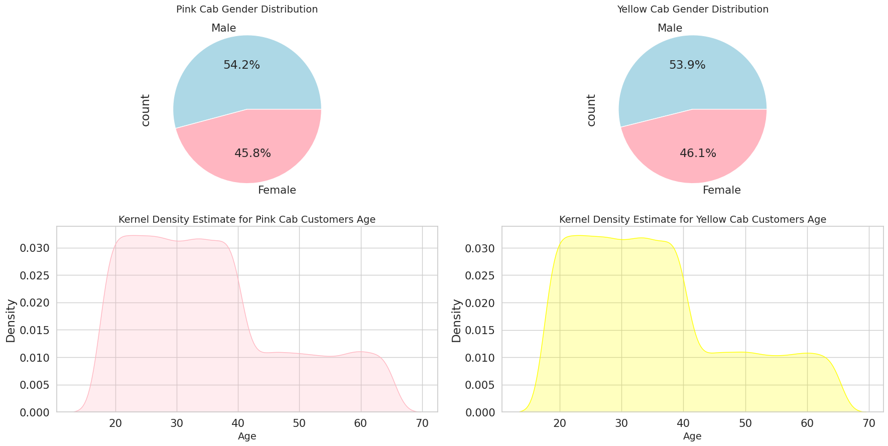
Is there any difference in customer demographics between the 2 companies?
Gender distribution for both companies are similar
About 54% male customers and 46% female customers
Age distribution for both companies are similar:
Mainly concentrated in the 20 – 40 age group

Slide 6
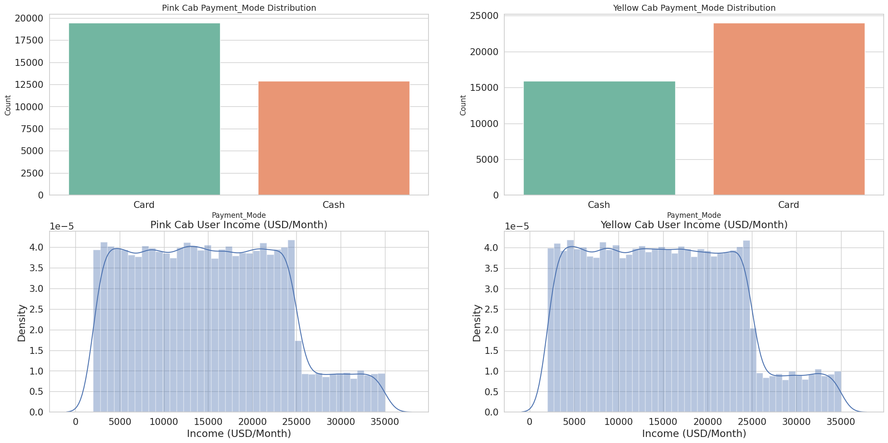
Is there any difference in customer demographics between the 2 companies?
Payment mode are similar:
Both are mainly card payment
Customer’s income level distribution are quite average:
Mainly concentrated below 25,000 USD/month

Slide 7
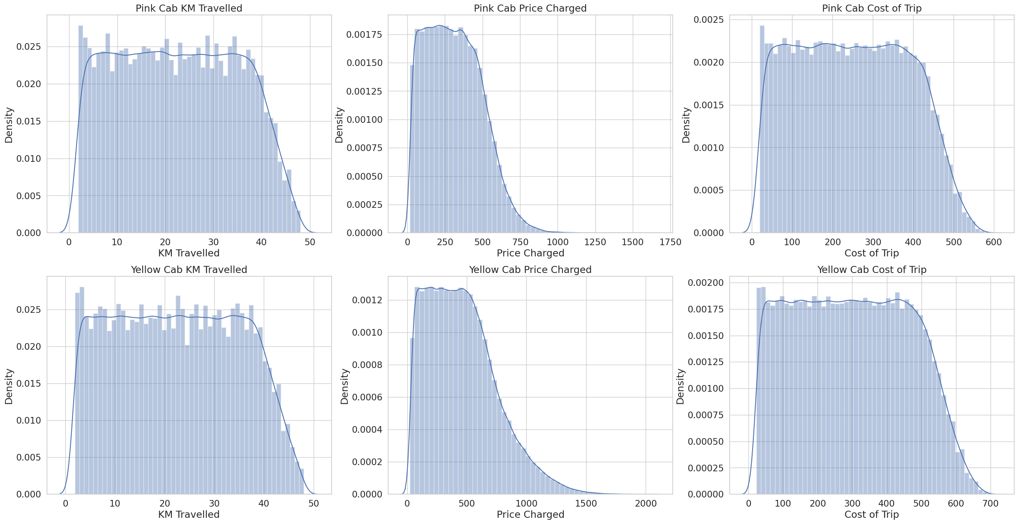
Is there any difference in company’s operations?
Yellow cab company seems to have higher price charged compared to the pink cab company.

Slide 8
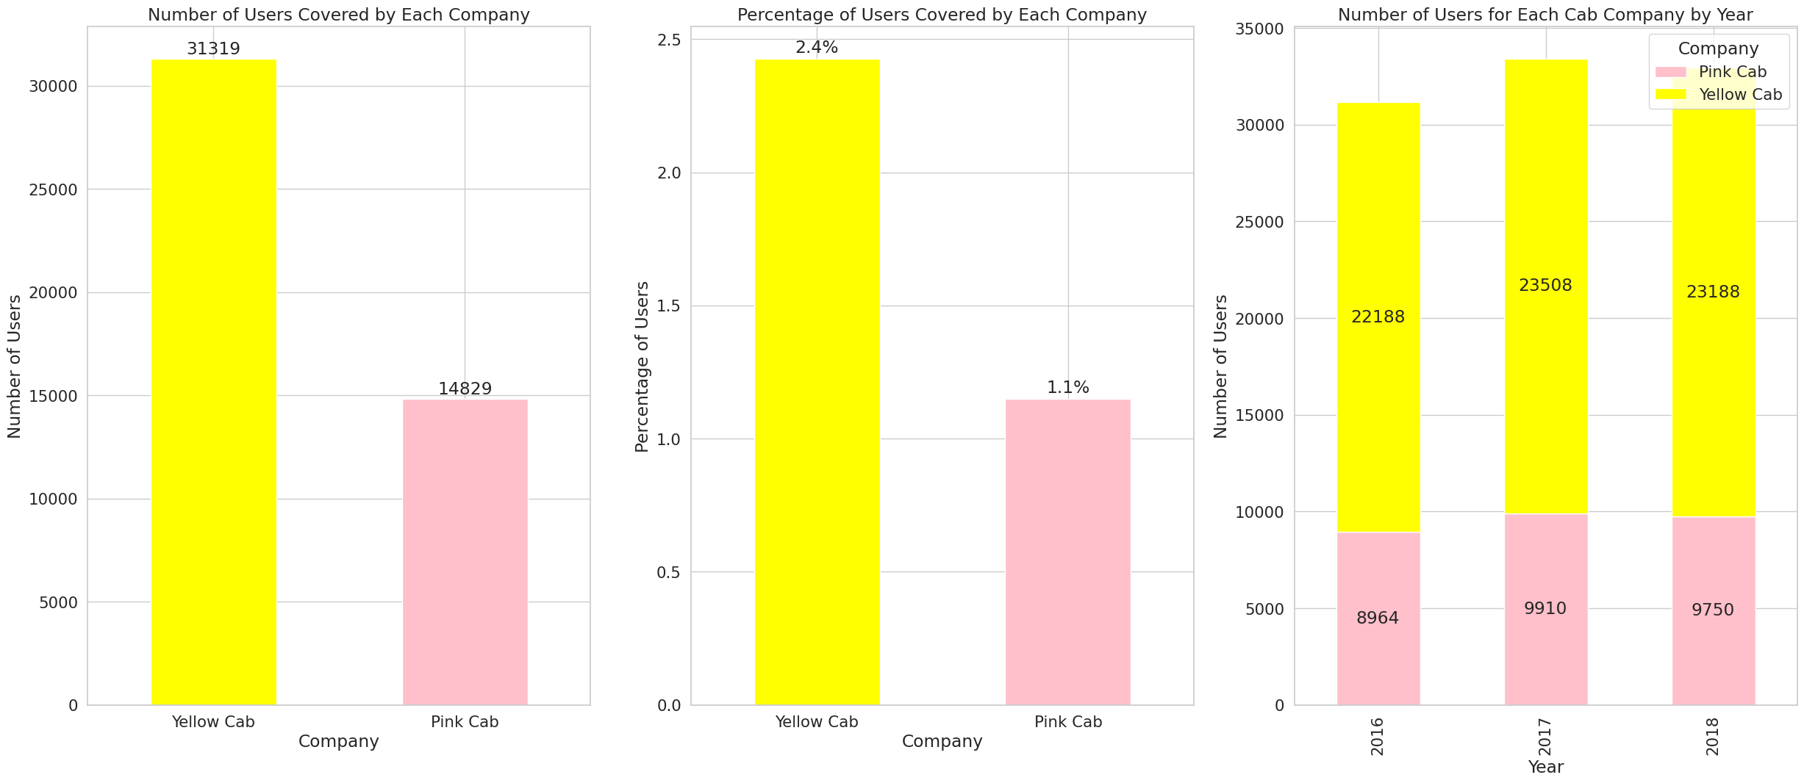
Which company has higher customer reach?
Yellow cab company obviously has higher customer reach compared to pink cab company, reach to almost twice the amount of unique customers of the pink cab, covers 2.4% of the entire cab customer market while pink only covers 1.1%.
Both companies faced a drop from 2017 to 2018, but pink cab decreased 1.61%, more than yellow cab’s 1.36%.

Slide 9
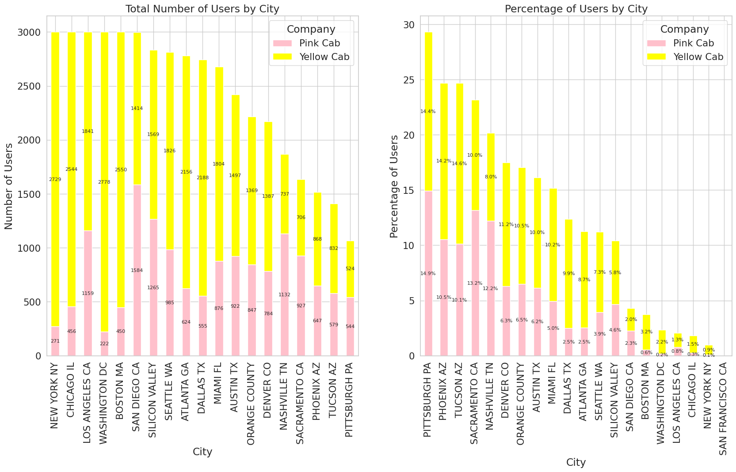
Which company has higher city coverage?
Yellow cab has significant higher coverage compared to pink cab (leading in 16 cities in a total of 19 cities).

Slide 10
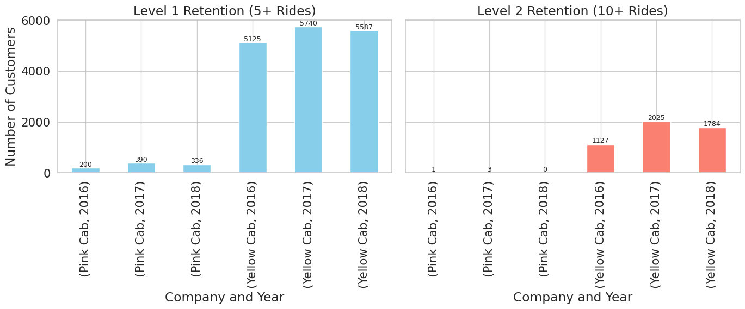
Which company has better customer retention?
We analyze customer retention by segmenting customers into 2 segments: 1 is customers who took at least 5 drive with the same cab company, and 1 is at least 10 drive with the same company, indicating more loyalty.
It is evident that Yellow Cab outperforms Pink Cab in both segments.

Slide 11
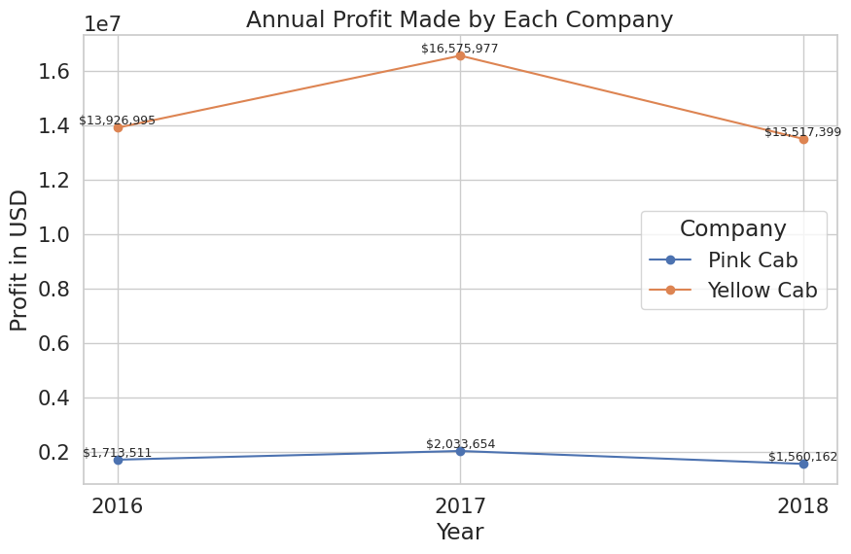
Which company makes more profit?
yellow cab company is significantly making more profit, around 11-14 million more than the pink cab company.
In 2017-2018, pink cab dropped 23% while yellow cab dropped 18%.

Slide 12
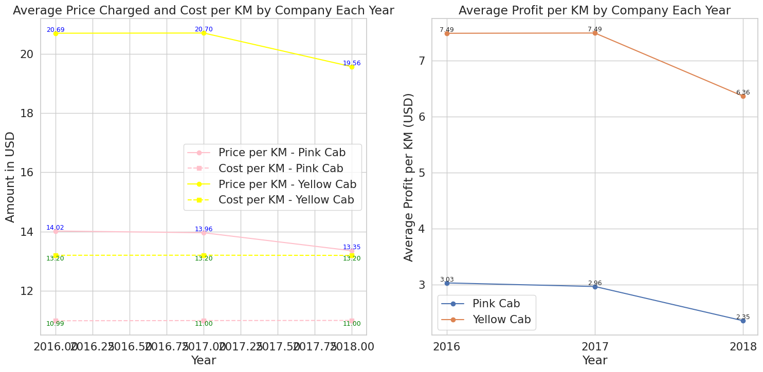
Which company makes more profit?
Yellow cab has an average of about 4 dollars more profit per KM than the pink cab, stronger profitability.

Slide 13
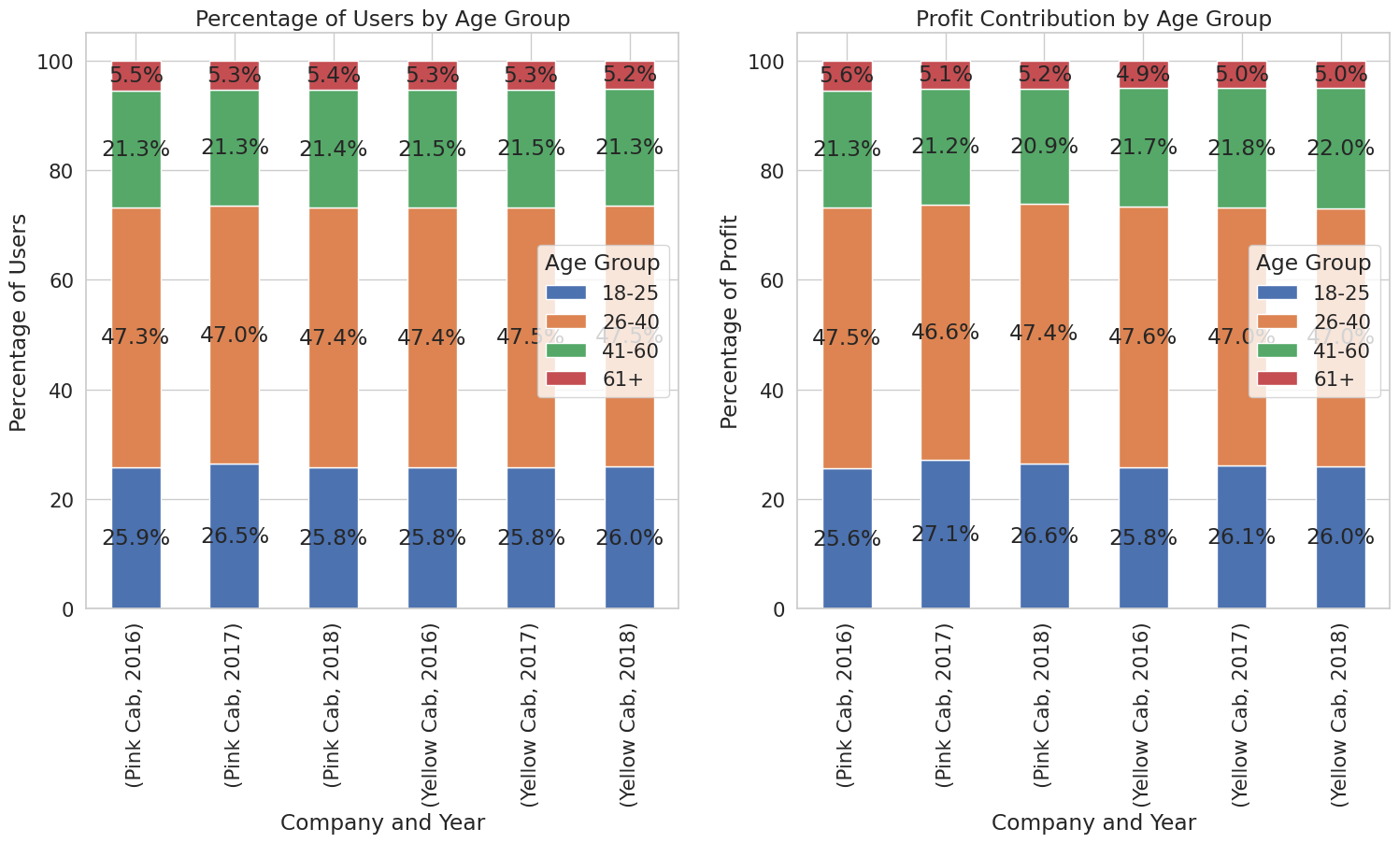
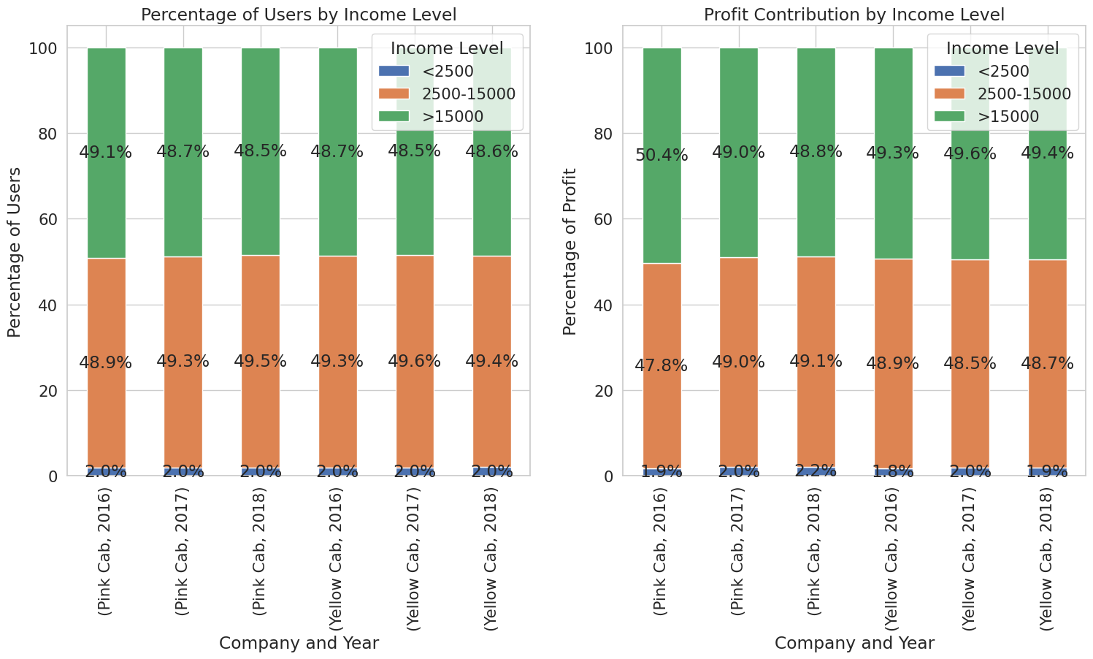
How does the customer attributes contributes to the company’s profit?

Slide 14
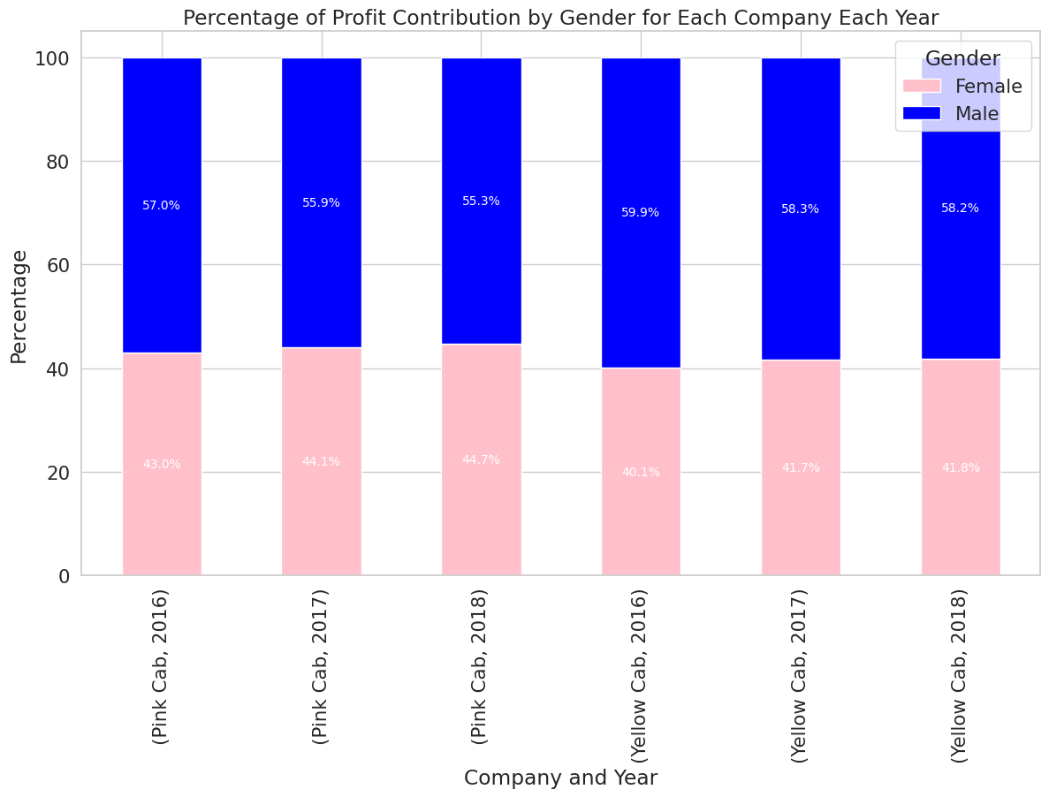
How does the customer attributes contributes to the company’s profit?
As predicted, gender, income level, and age group contribution to profit have no significant difference between the 2 companies all genders between the ages of 18 to 40 that are at the middle and high-income level contribute most to companies' profit.

Slide 15
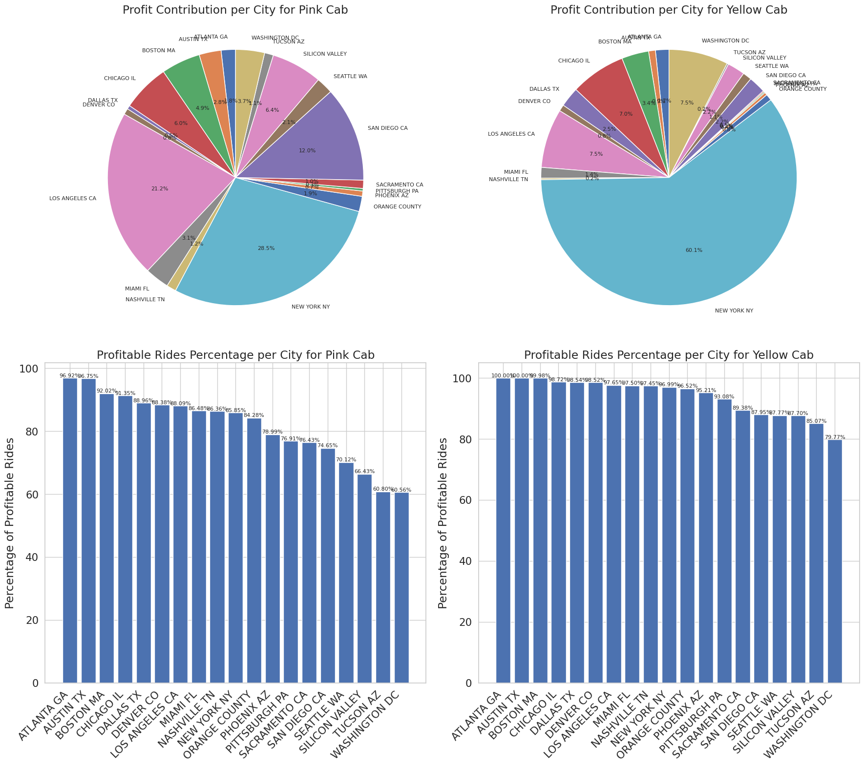
How does the customer attributes contributes to the company’s profit?
New York cab users contributed 60.1% of the profit for the yellow cab company while only 28.5% for the pink cab company. Yellow cab has a stronger presence in more developed cities with higher demands for cabs, and have higher profitable rides percentage in basically all cities compared to pink cabs.

Slide 16
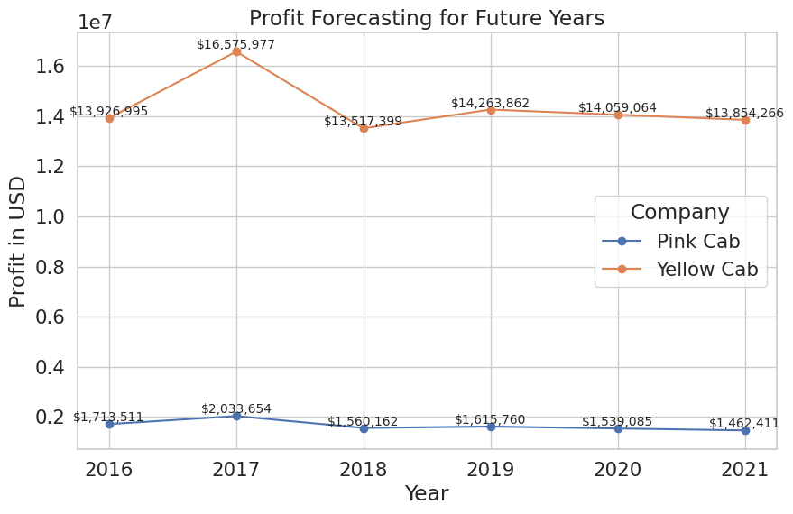
Which company has better future prospects?
Pink cab has lesser increase in 2019 than yellow cab and higher decrease from 2019 to 2021 than yellow cab.

Slide 17
Recommendations
Demographics:
User demographics for the yellow and pink companies are very similar. Both companies' users have almost identical gender distribution, age distribution, and income level distribution. The main age group for both cab companies is 18-40, and both are very popular in high and medium-income classes, indicating strong future development potential and steady revenue.
User Reach:
Yellow cab company has 31,319 unique users while Pink Cab company has 14,829, about twice the amount of users. Yellow cab covers 2.4% of total cab users compared to pink cab's 1.1%, a significantly larger market. Both companies' users amount have faced a drop in users from 2017 to 2018, yellow cab decreased by about 1.36% while pink cab decreased by 1.61%.
City Coverage:
Out of 19 cities, pink cab only reached more users, and has a higher user percentage in 3 cities, while yellow cab has more users in 16 others.
User Retention:
After analyzing this in two segments: at least 5 drive and at least 10 drive with the same cab company, it is evident that Yellow Cab outperforms Pink Cab in both segments. This indicates that Yellow Cab is more effective in retaining its customers than Pink Cab.

Slide 18
Recommendations
Profit:
We can see that the yellow cab company is significantly making more profit, around 11-14 million more than the pink cab company. Both faces decreased from 2017 to 2018, pink cab dropped 23% while yellow cab dropped 18%, indicating better stability for yellow cab company.
Even though the yellow cab has a higher cost per KM compared to the pink cab, with a higher price per KM yellow cab has an average of about 4 dollars more profit per KM than the pink cab, stronger profitability.
As predicted, gender, income level, and age group contribution to profit have no significant difference between the 2 companies all genders between the ages of 18 to 40 that are at the middle and high-income level contribute most to companies' profit.
New York cab users contributed 60.1% of the profit for the yellow cab company while only 28.5% for the pink cab company. We can see that yellow cab has a stronger presence in more developed cities with higher demands for cabs, and have higher profitable rides percentage in basically all cities compared to pink cabs, indicating stronger future potential.
Yellow cab has a 5.5% predicted increase in 2019 and a 2.87% decrease in the future 3 years from 2019 to 2021, while pink cab has a 3.6% predicted increase in 2019 and a 9.49% decrease in the future 3 years from 2019 to 2021. There is a lesser increase and more decrease for the pink cab compared to the yellow cab.
Conclusion:
Based on the above points, I recommend the yellow cab company for investment.

Slide 19
Thank You

